Slide 1

Bison Invaders
Presented by: The Golden Oreo
JONATHAN LI | YUXUAN HUANG | JOSEPH ELVIN

Slide 2
Task Division
Yuxuan Huang (Project Owner)
Main game framework
control, view, mode
Team management
Jonathan Li (Scrum Master)
Graphics, Scrum, Readjustments to Game
Joe Elvin (Developer)
UML + associated classes
Graphics
Documentation + Unit testing

Slide 3
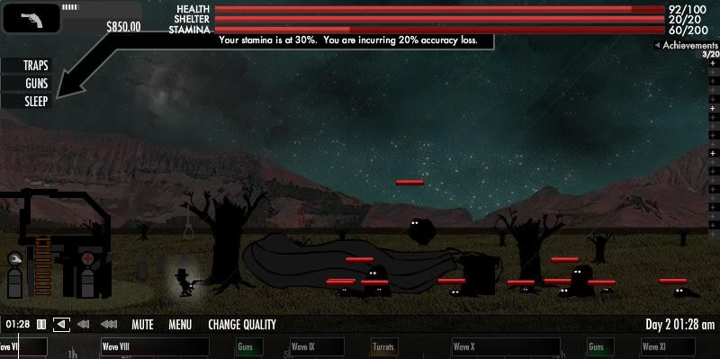
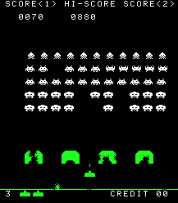
Why?
Inspiration on two games, Balloon in a Wasteland and the classic Space Invaders with a Bucky the Bison themed twist.

Slide 4
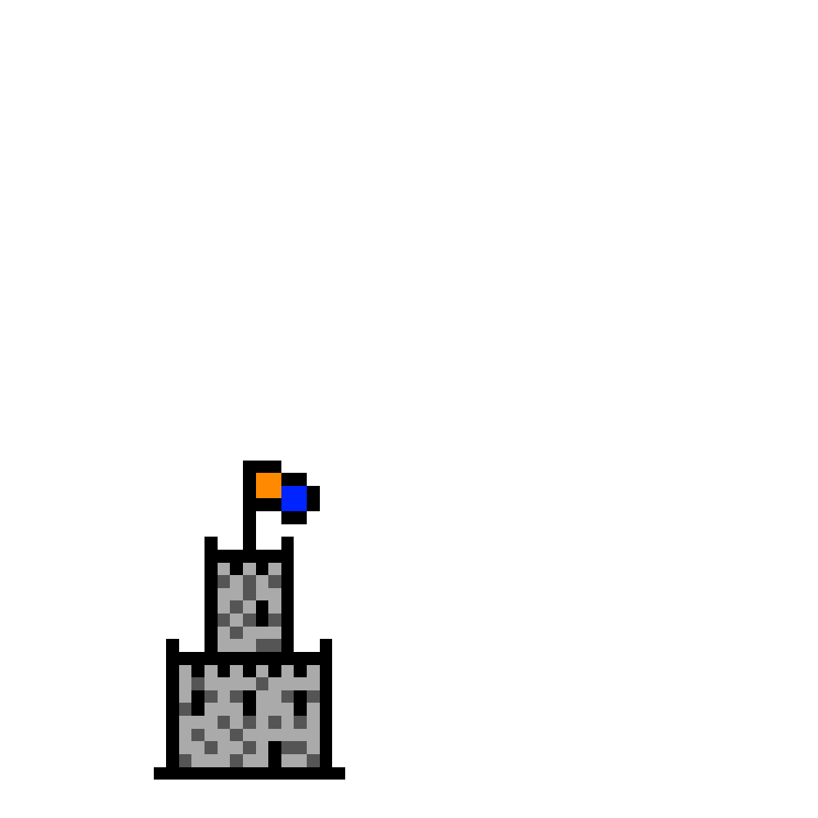




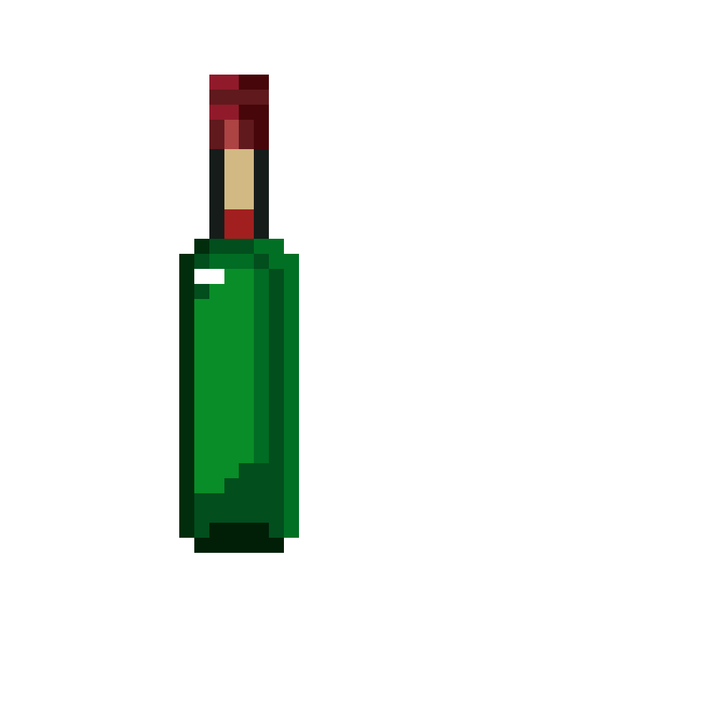


Objects(Not OOP!) and Entities
Used Gimp to Build 16-Bit Player, Enemies, Castle, and Weapons

Slide 5
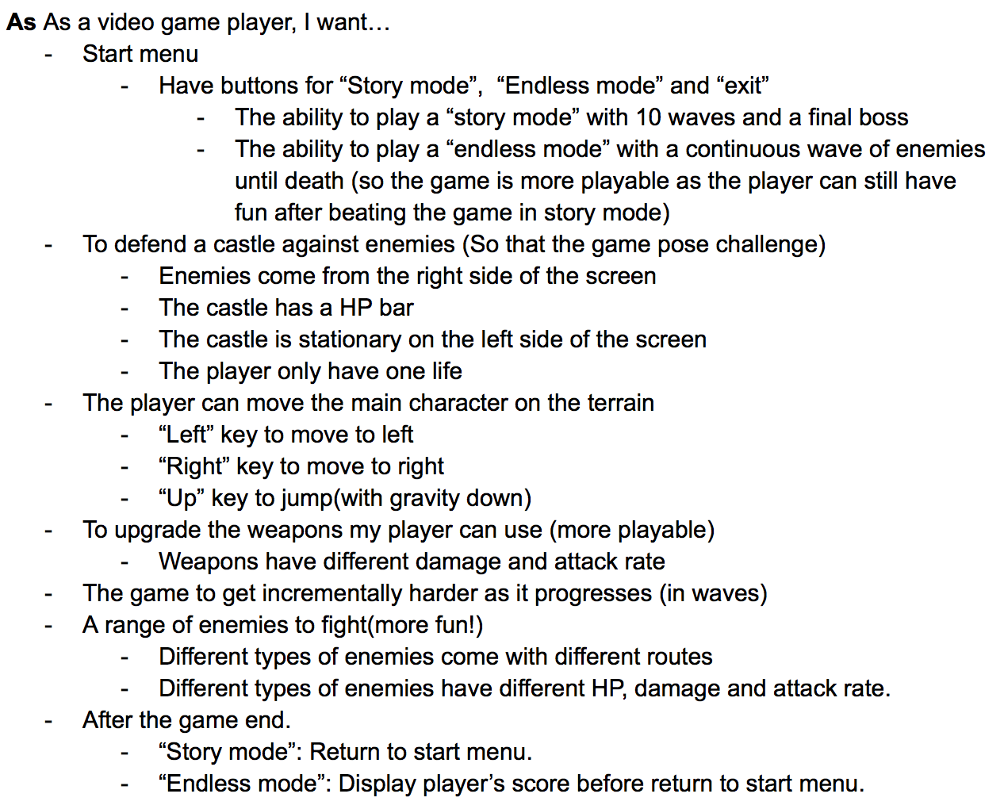
User Stories

Slide 6
User Interface
All entities(players, enemies, etc…) were png files
4 PNG Images that served as screen overlays
Start Menu
Play Screen
Winning Screen
Losing Screen
The entities are juxtaposed on top of the screens.
Used a .gif file for the retro game font

Slide 7
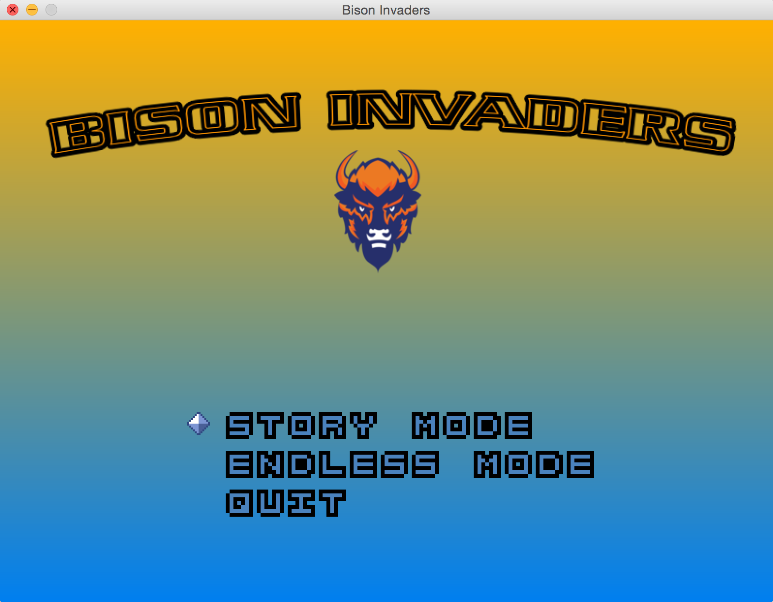

Slide 8
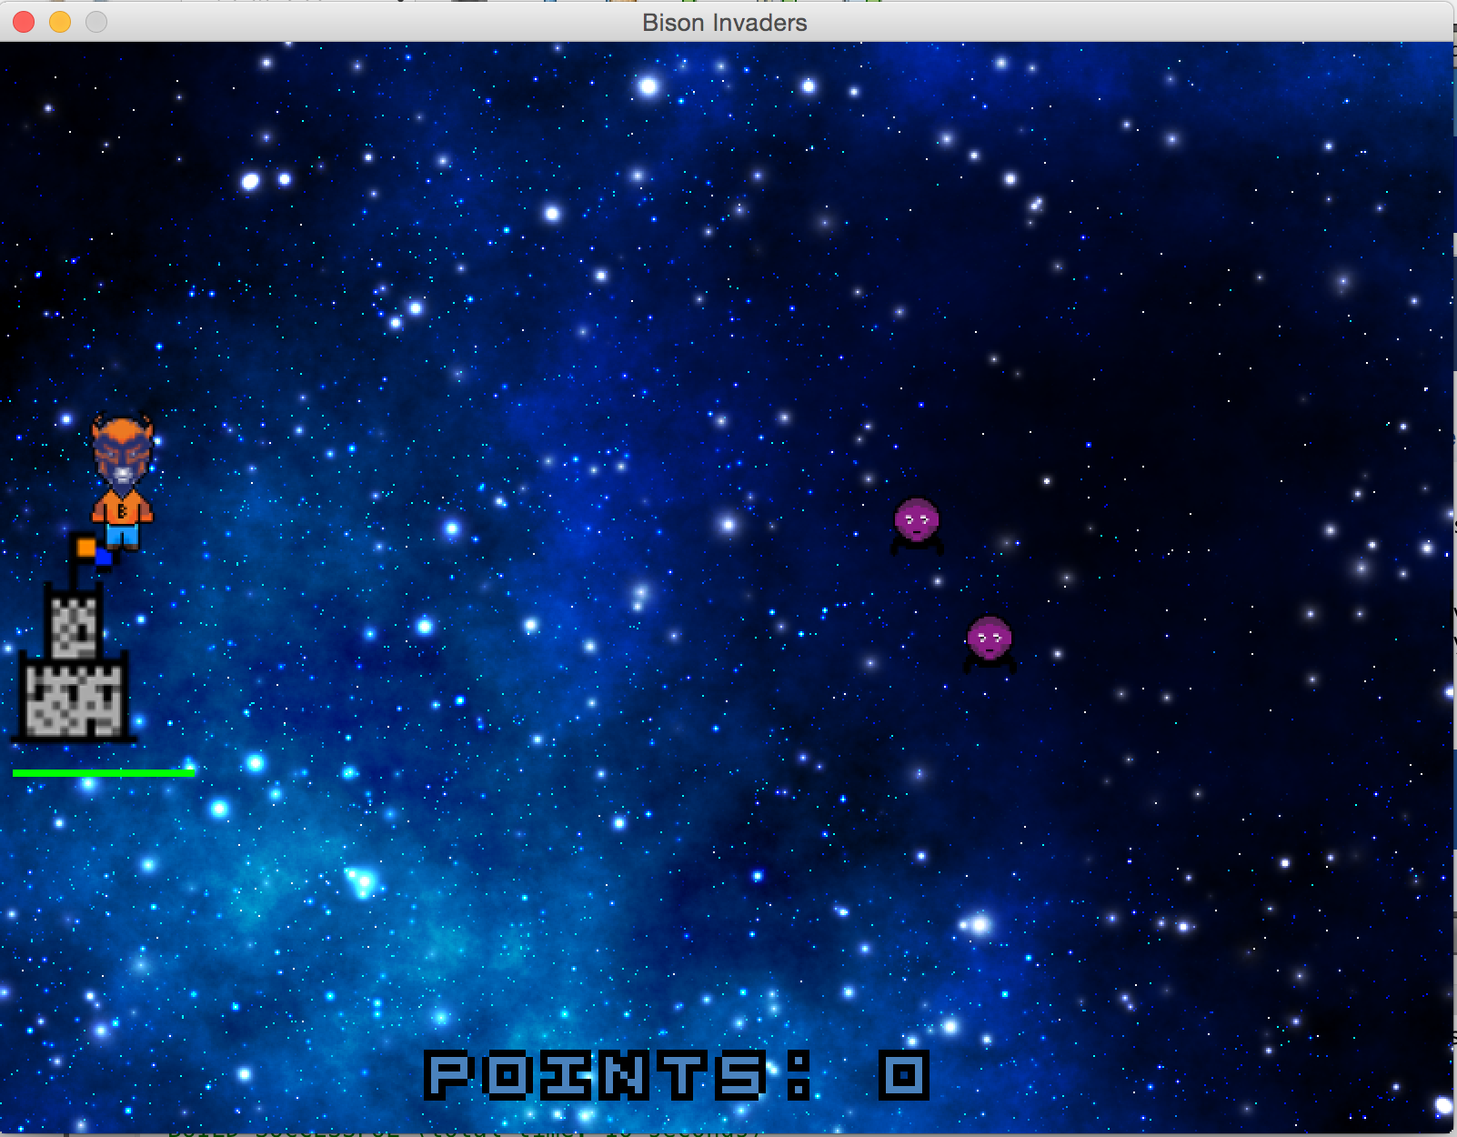

Slide 9
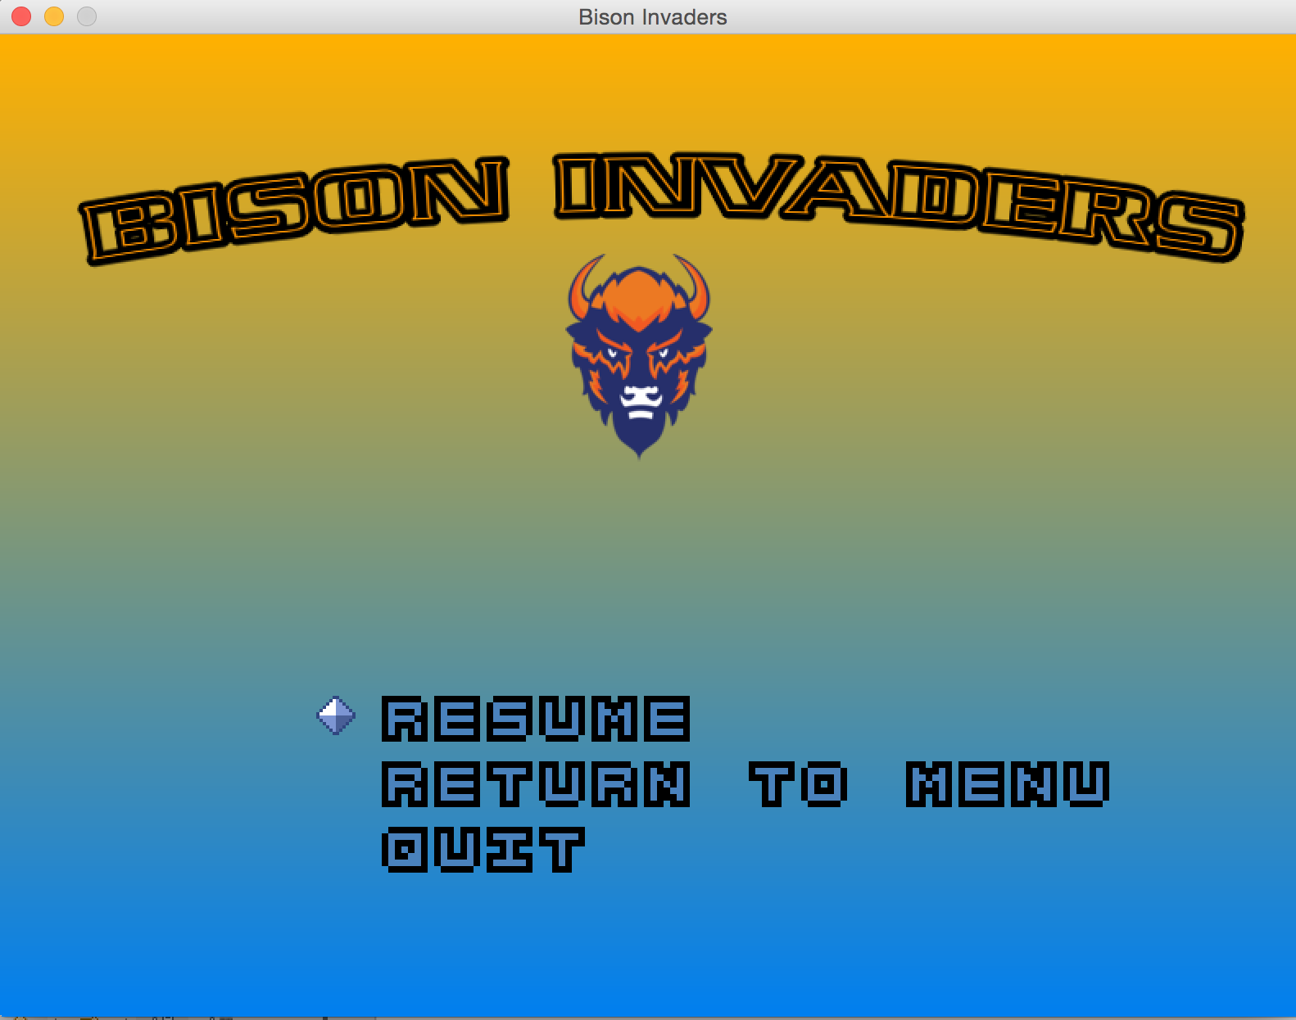

Slide 10
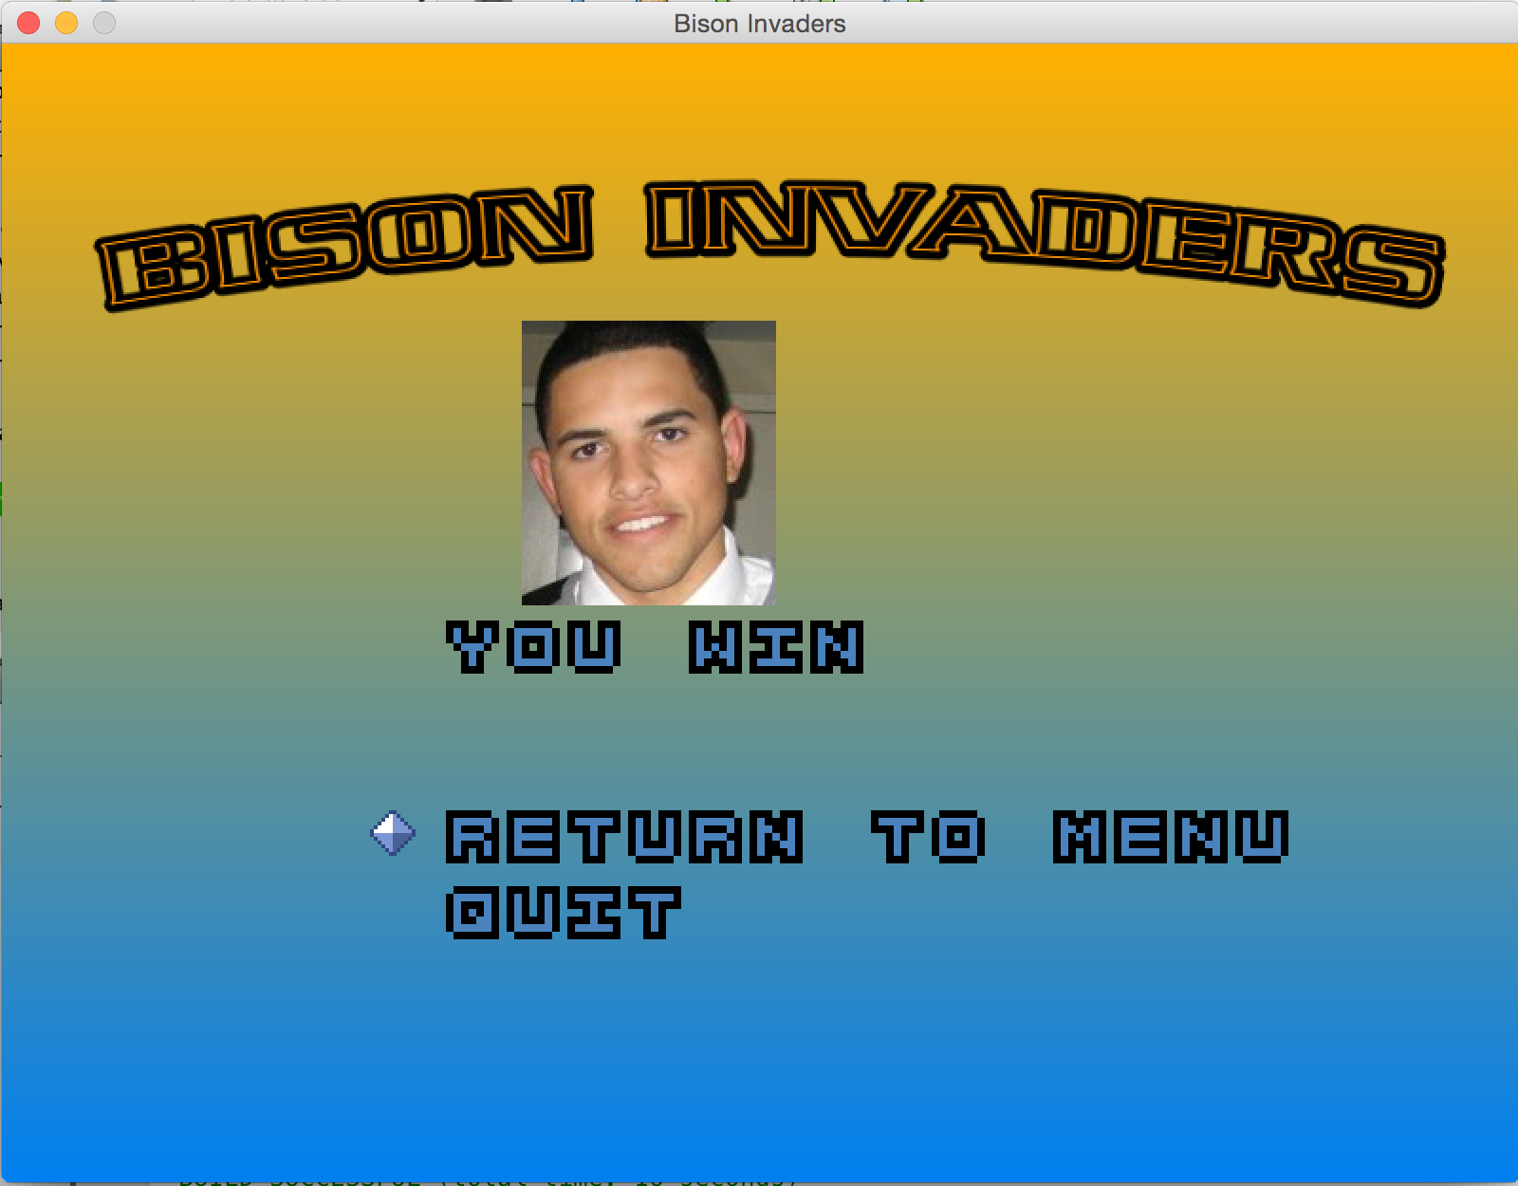

Slide 11
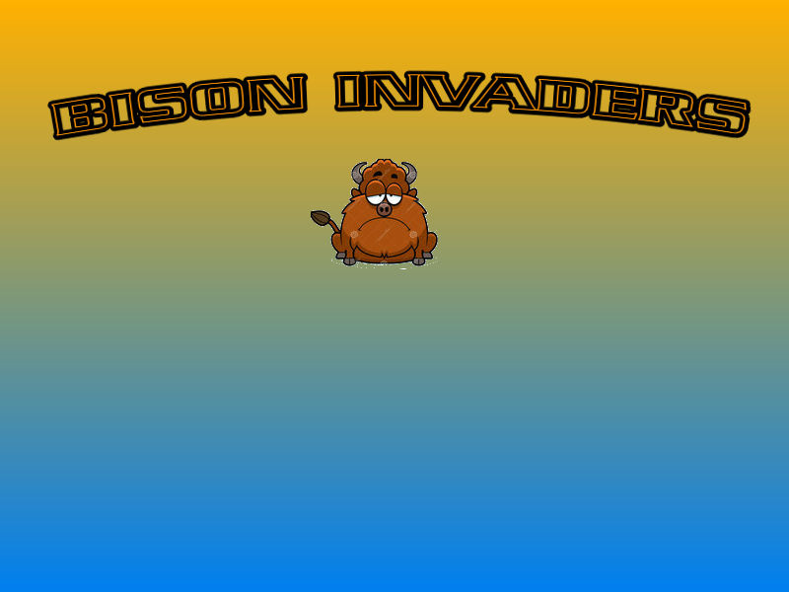

Slide 12
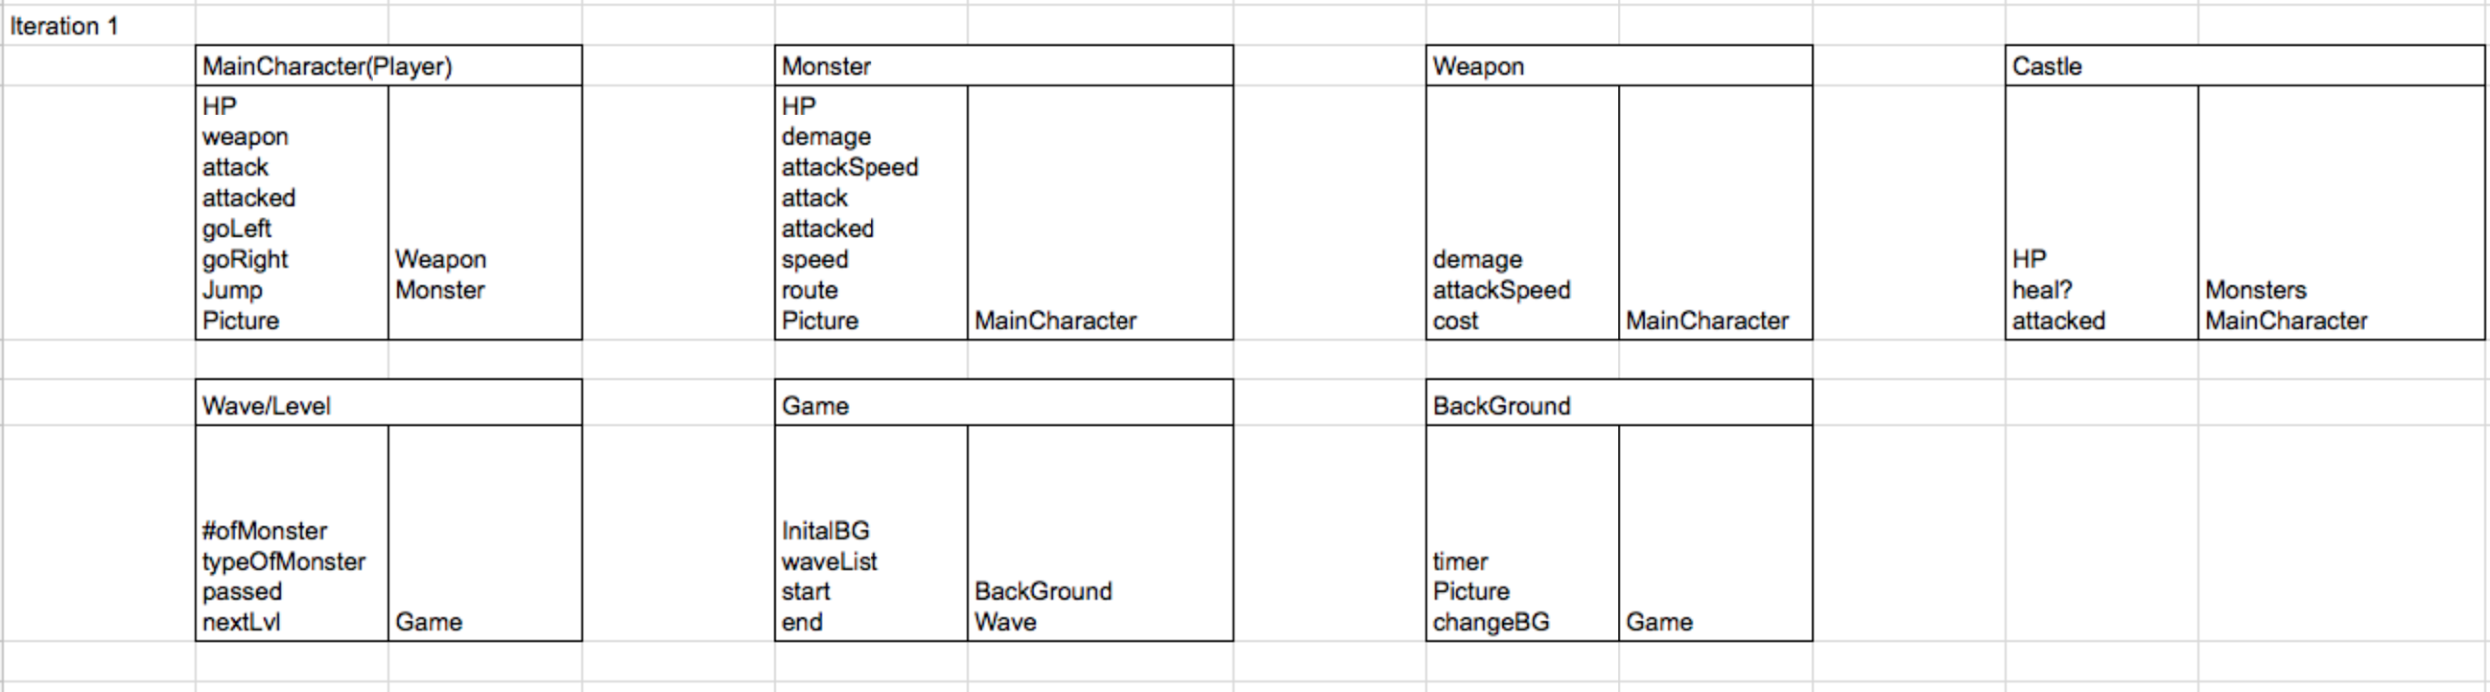
CRC Cards(First iteration)

Slide 13
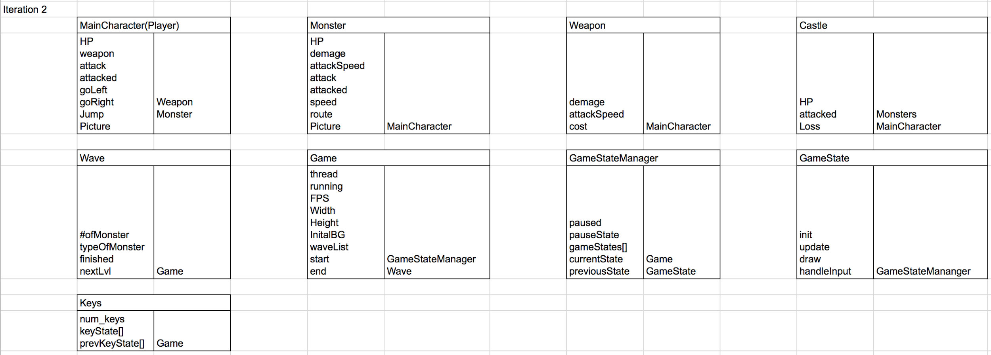
CRC Cards(Second Iteration)

Slide 14
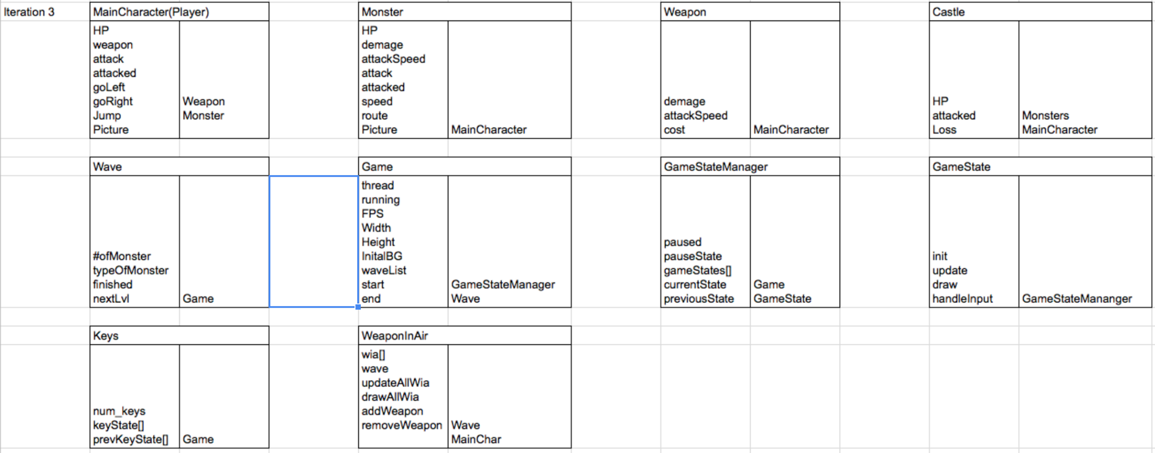
CRC(Third Iteration)

Slide 15
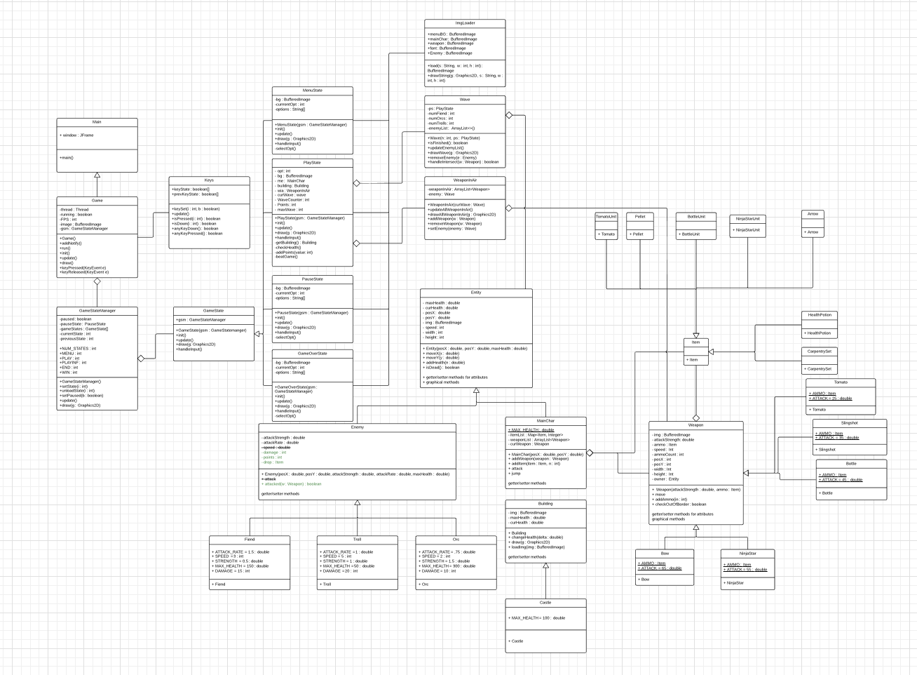
UML Diagram

Slide 16
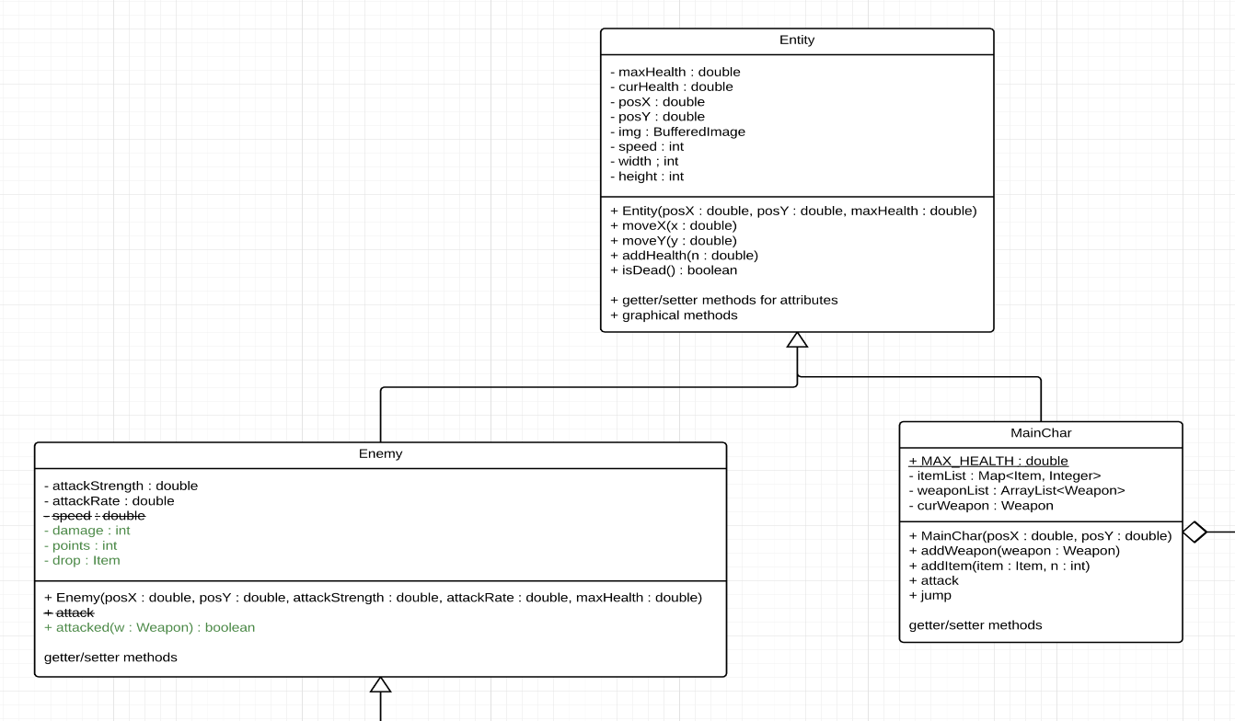
UML Diagram

Slide 17
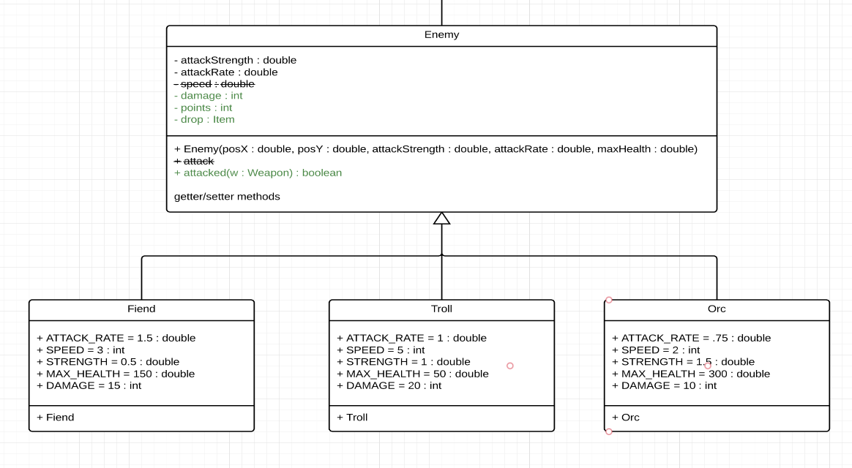
UML Diagram

Slide 18
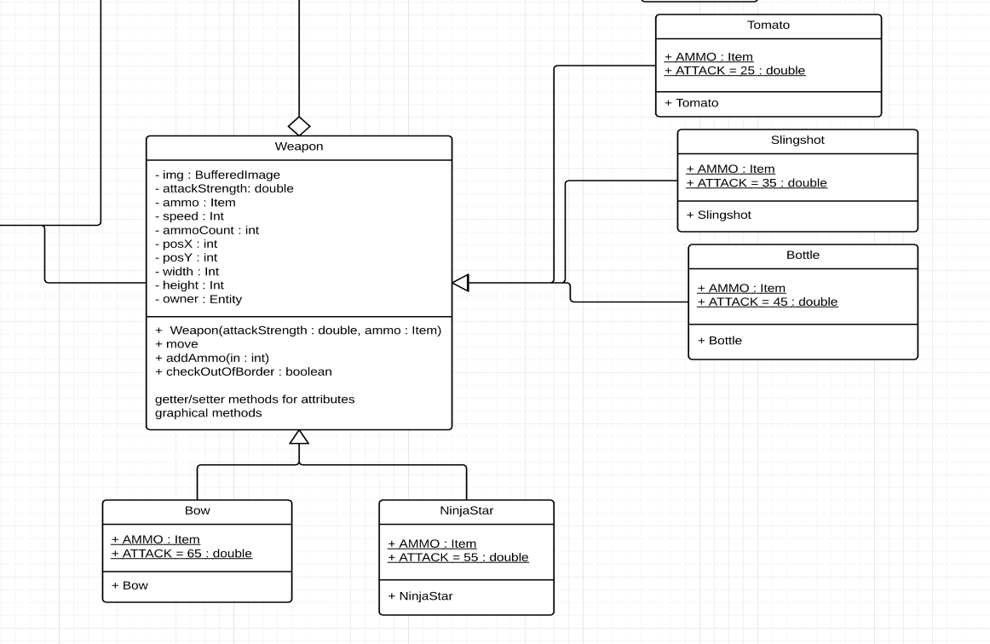
UML Diagram

Slide 19
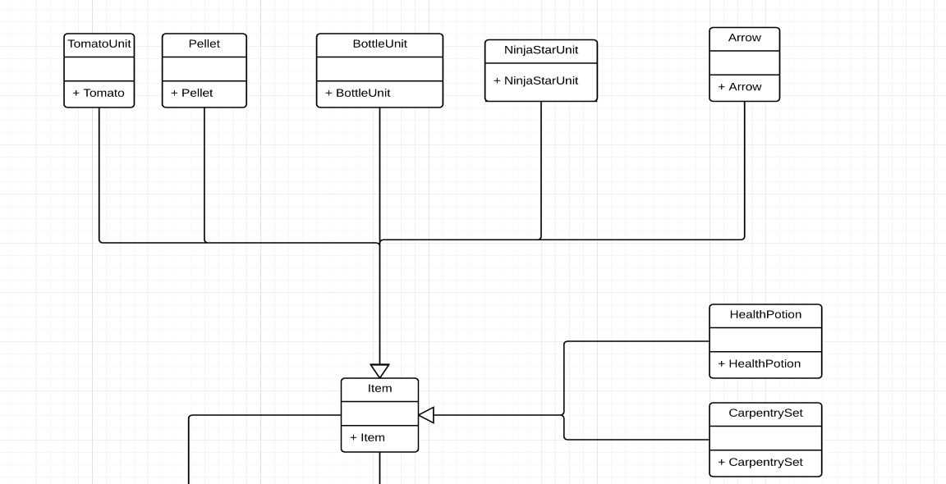
UML Diagram

Slide 20
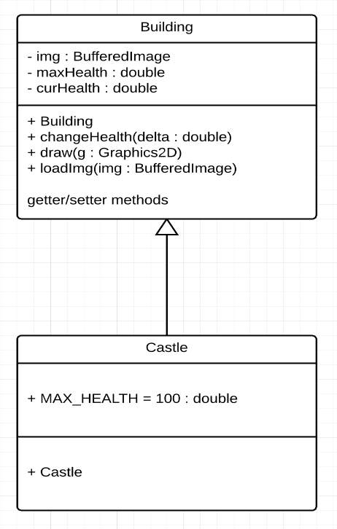
UML Diagram

Slide 21
Game Framework Design

Slide 22
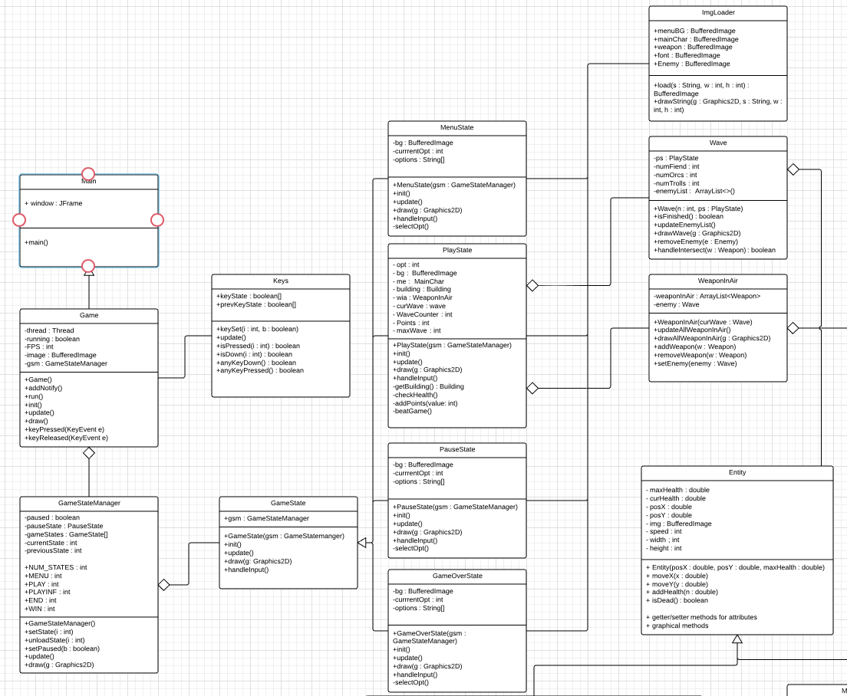

Slide 23
Implementation: The SCRUM Process

Slide 24
TaskBoard
Implement the proper physics
Have a Start Menu
Wave Progression Bar
Fireable weapons
Changing Weapons
Pause Games
Wave Difficulty
Protagonist Class
Enenmy Class
Move Methods
Defendable Castle
Collision Accountabillity
Main Game
Two Game Modes
Add Game Audio
Deaths
GUI seamlessness
Movement on GUI
Buttons for Story Mode,, Exit, Endless Mode
HP Bars that Change
Enemies Drop Weapons
Different Travel Patterns of Enemies
Slightly Varying Background GUI as game Progresses
Ending Graphics for Beating Game
Credits to Authors / Creators
Different Attack Rates and Damage
Potential Animation for Dead Enemies(Sizzle and a Pop)
Using key presses to Move the Player
Ability to Change the Appearance??
Win Screen
Lose Screen
Edge Conditions

Slide 25
Sprints
Sprint 1: Creating Entities, Buildings, Weapons
Sprint 2: Framework for Game
Sprint 3: Functionality and Cases like Intersection
Sprint 4: Trying to Add more Functionality, Fixing Mistakes, aesthetics

Slide 26
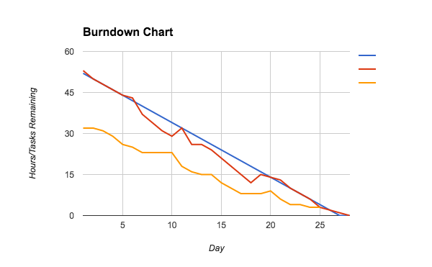
Burndown Chart
Estimated Time: 52 Hours, Actual: 53
Blue is Estimated
Red Is Actual Time Left
Yellow is number of tasks left

Slide 27
Strengths and Weaknesses
Strengths:
Nicely breakdown the project into small achievable goals
Following Design Conventions
Weak
Implementation
Organization in Design
For the Future
More team meetings earlier on, it’s better to be cohesive in the beginning and moving to do own components than the other way around

Slide 28
Future Improvements
Enable “Animation” of the moving objects
Sound effect and BGM
Weapon Upgrade mechanism
Better “Story” for story mode
Large teams are harder to work with, we should have had a divergent trajectory rather than converging and then diverging.

Slide 29
Thanks for listening….now the demonstration!

